Slide 1
Explanation on TensorFlow Example
- Deep MNIST for Experts -

Slide 2
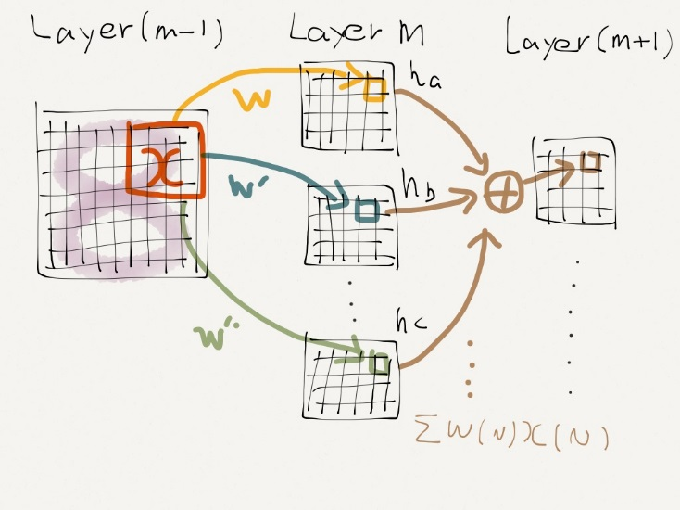
Networks Architecture
32 features
32 channels
64 features
64 features
convolution
(5x5,s=1)
A
Max pooling
(2x2,s=2)
Max pooling
(2x2,s=2)
x_image
(28x28)
convolution
(5x5,s=1)
h_conv1
(28x28x32)
h_pool1
(14x14x32)
h_conv2
(14x14x64)
h_pool2
(7x7x64)
1st convolutional layer
2nd convolutional layer
. . .
A
Fully connected layer
Readout layer
Reshape
7 * 7 * 64 Tensor ➔ 3,136x1 vector
1,024 neurons
10 digits

Slide 3
Computation process consists of two phases
Define phase : Computation result is not determined
Define data and model
Construct learning model
Define cost function and optimizer
Run phase : can get a computation result
in the case of putting model into session
Execute computation
Learning process using optimizer
To execute the graph,
Needs to connect with Core module
Real computation is performed in Core module

Slide 4
Define phase
import tensorflow as tf
# Import MINST data
import input_data
mnist = input_data.read_data_sets("MNIST_data/", one_hot=True)
sess = tf.InteractiveSession()
# tf Graph Input
x = tf.placeholder("float", [None, 784]) # mnist data image of shape 28*28=784
y_ = tf.placeholder("float", [None, 10]) # 0-9 digits recognition => 10 classes
x_image = tf.reshape(x, [-1, 28, 28, 1])
# Define initial values of Weight and bias
def weight_variable(shape):
# mean = 0.0
initial = tf.truncated_normal(shape, stddev=0.1)
return tf.Variable(initial)
def bias_variable(shape):
initial = tf.constant(0.1, shape=shape)
return tf.Variable(initial)
Reshape 1x784 ➔ 28x28
To break symmetry,
a little bit of noise on
Weight and bias

Slide 5
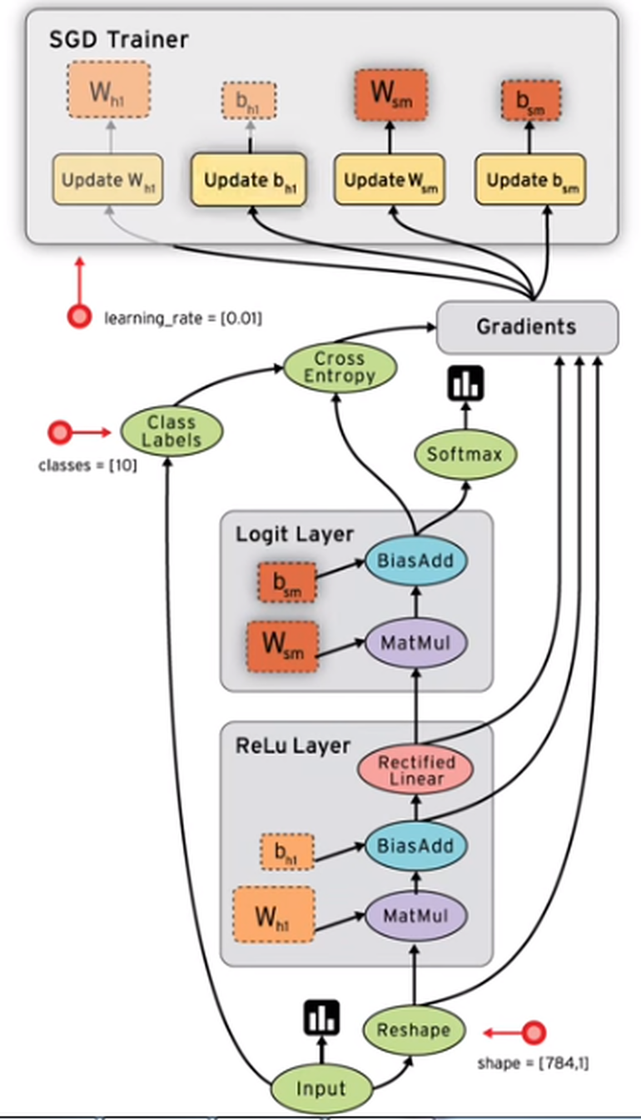
Define phase
Placeholder
To feed data into any Tensor in a computation graph
Inputs x : training images
y : correct answer
Needs to define tensor form in advance
It uses in running process later
placeholder(<data type>,shape=<optional shape>, name=<optional-name>)
x = tf.placeholder("float", [None, 784]) # mnist data image of shape 28*28=784
y = tf.placeholder("float", [None, 10]) # 0-9 digits recognition => 10 classes
feed_dict={x: batch_xs, y: batch_ys}
Feed “batch_xs” into “x” placeholder

Slide 6
Define phase
# Define convolution & max pooling function
def conv2d(x, W):
return tf.nn.conv2d(x, W, strides=[1, 1, 1, 1], padding='SAME')
[batch, horizontal stride, vertical stride, channels] , zero padding so that the sizes of input & output are “same”
def max_pool_2x2(x):
return tf.nn.max_pool(x, ksize=[1, 2, 2, 1], strides=[1, 2, 2, 1], padding='SAME')
[batch, pooling size(2x2), channels]
# Define 1st convolutional layer
# 5x5 patch size of 1 channel, 32 features
W_conv1 = weight_variable([5, 5, 1, 32])
[Filter size(5x5), # of ch.(1), # of features(32)]
b_conv1 = bias_variable([32])
[# of features(32)]
h_conv1 = tf.nn.relu(conv2d(x_image, W_conv1) + b_conv1)
h_pool1 = max_pool_2x2(h_conv1)
# Define 2nd convolutional layer
# 5x5 patch size of 32 channel, 64 features
W_conv2 = weight_variable([5, 5, 32, 64])
b_conv2 = bias_variable([64])
h_conv2 = tf.nn.relu(conv2d(h_pool1, W_conv2) + b_conv2)
h_pool2 = max_pool_2x2(h_conv2)
A 4-D `Tensor` with shape `[batch, height, width, channels]`

Slide 7
Define phase
# Define fully connected layer
# image size reduced to 7x7, full connected with 1024 neurons
W_fc1 = weight_variable([7 * 7 * 64, 1024])
b_fc1 = bias_variable([1024])
h_pool2_flat = tf.reshape(h_pool2, [-1, 7 * 7 * 64])
h_fc1 = tf.nn.relu(tf.matmul(h_pool2_flat, W_fc1) + b_fc1)
# Apply Dropout
keep_prob = tf.placeholder('float')
h_fc1_drop = tf.nn.dropout(h_fc1, keep_prob)
for training (with keep_prob < 1.0, dropout is active) and evaluation (with keep_prob == 1.0, dropout is inactive).
# Define readout layer
W_fc2 = weight_variable([1024, 10])
b_fc2 = bias_variable([10])
y_conv = tf.nn.softmax(tf.matmul(h_fc1_drop, W_fc2) + b_fc2)
Reshape 7 x 7 x 64 ➔ 3,136x1

Slide 8
Define phase
Dropout
A simple way to prevent neural networks from overfitting and to build robust NN
Only active during training phase
Underfitting
Moderate
Overfitting

Slide 9
Define phase
# Define loss function
cross_entropy = -tf.reduce_sum(y_ * tf.log(y_conv))
# Define model training
train_step = tf.train.AdamOptimizer(1e-4).minimize(cross_entropy)
optimization with Adamoptimizer to minimize cross entropy
correct_prediction = tf.equal(tf.argmax(y_conv, 1), tf.argmax(y_, 1))
Returns the index with the largest value across dimensions of a tensor
Return “1” if argmax(y_conv, 1) = argmax(y_, 1), otherwise return “0”
accuracy = tf.reduce_mean(tf.cast(correct_prediction, 'float'))
Casts a tensor to “float”
calculate mean value

Slide 10
tf.argmax(input, dimension, name=None)
Returns the index with the largest value across dimensions of a tensor.
Args:
input: A Tensor. Must be one of the following types
dimension: A Tensor of type int32. int32, 0 <= dimension < rank(input). Describes which dimension of the input Tensor to reduce across.
For vectors, use dimension = 0.
tf.cast(x, dtype, name=None)
Casts a tensor to a new type.
The operation casts x (in case of Tensor) or x.values (in case of SparseTensor) to dtype.
For example:
# tensor `a` is [1.8, 2.2], dtype=tf.floattf.cast(a, tf.int32) ==> [1, 2]
Args:
x: A Tensor or SparseTensor.
dtype: The destination type.
name: A name for the operation (optional).

Slide 11
Run phase

Slide 12
Run phase
sess.run(tf.initialize_all_variables())
for i in range(20000):
batch = mnist.train.next_batch(50)
Each training iteration we load 50 training examples
if i%100 == 0:
train_accuracy = accuracy.eval(feed_dict={x:batch[0], y_: batch[1], keep_prob: 1.0})
accuracy.eval() is equivalent to calling tf.get_default_session().run(accuracy)
print "step %d, training accuracy %g" % (i, train_accuracy)
train_step.run(feed_dict={x: batch[0], y_: batch[1], keep_prob: 0.5})
run the train_step operation, using feed_dict to replace the placeholder tensors x and y_ with the training examples. . Dropout is active
print "test accuracy %g" % accuracy.eval(feed_dict={x: mnist.test.images, y_: mnist.test.labels, keep_prob: 1.0})
run the test operation, using feed_dict to replace the placeholder tensors x and y_ with the test examples. Dropout is inactive
Printout training accuracy at every 100 steps

Slide 13
Test Results
Accuracy ~ 99%

Slide 14
More Deep Architecture
Just add additional layers if you want
CPCPFF ➔ CCPCCPFF
Two additional convolutional layers

